Slide 1
Dragons’ Reign
Jordon Kopp
Vince Smeraldo
Derek Finch
Matt Kalafut
Mark Muniz
Josh Kopp

Slide 2
Team Roles
Team Lead
Jordon Kopp
Lead Programmer
Vince Smeraldo
Programmers
Matt Kalafut
Mark Muniz
Derek Finch
Josh Kopp
Designer
Marco Malek
Out sourced artist

Slide 3
Scope/Purpose Statement
Scope
To develop a standalone, functioning prototype for a top-down 2D fantasy RPG on the Android platform
Purpose
To entertain an audience on a mobile platform, capable of being played anywhere at any time

Slide 4
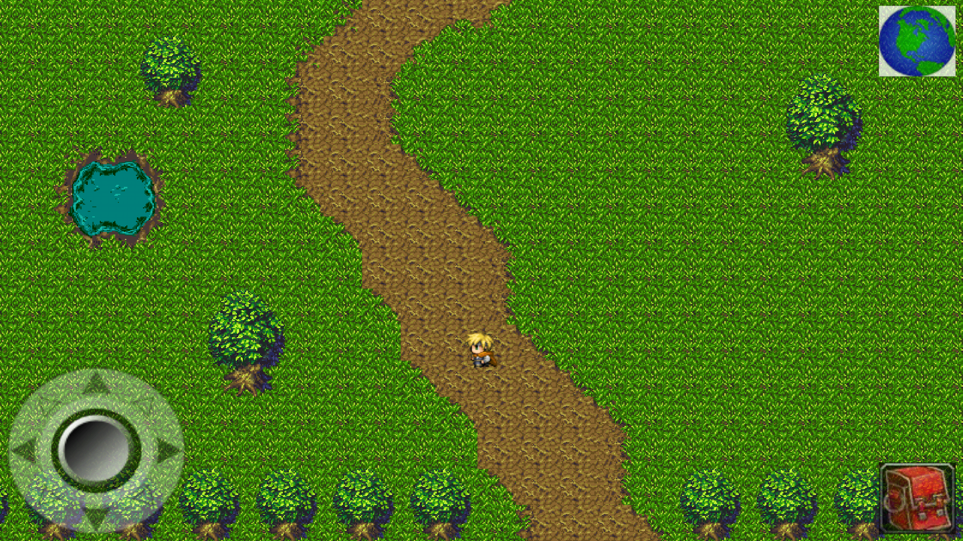
Player Screen/User Interface

Slide 5
Milestones
Finalized GDD (Game Design Document)
Finalized TDD (Technical Design Document)
Finished UI
Finished battle system
Finish character class
Finished playable zone
Finished major city
Finished completed game

Slide 6
Project Planning

Slide 7
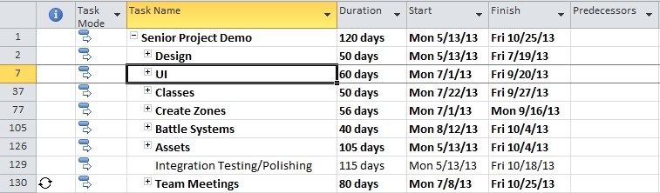
Project Planning

Slide 8
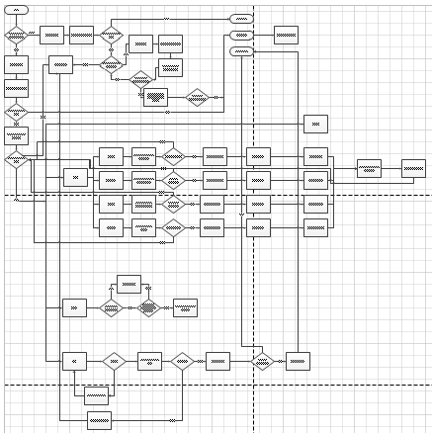
Project Planning: Battle System

Slide 9
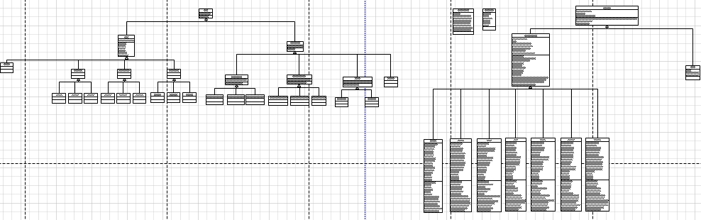
Project Planning: Character Class Diagrams

Slide 10
Development Environment
Android SDK
Java
Eclipse
Tiled
Tile Engine
TexturePacker
Creates Sprite Sheets
GitHub
Version Control
Online Repository
GIMP 2
Art Editing Tool

Slide 11
Assets
Art
Open-Source
Freelance Artist
Audio
Open-Source

Slide 12
Game Summary
Backstory
The world is unaware of the presence of dragons within their peaceful societies. Until that fateful day when dragons awakened, the world was never the same.
Story
Dragons have awakened in each of the regions and the local hostile tribes now worship them as Gods. It is the duty of the player to defeat the dragons in each of the regions, shattering the hostile tribes that worship them in the process. This eventually leads to defeating the Elder Dragon to rid the world of dragons forever.

Slide 13
Classes
Warrior
Cleric
Ranger

Slide 14
Attributes
Strength
Increases physical damage
Dexterity
Increases physical damage
Physical critical strike chance
Vitality
Increases base health
Intelligence
Increases spell damage
Spell critical strike chance

Slide 15
Warrior Description
Master of brute force melee combat, capable of frightening the foe with appearance alone. Prefers the simple lifestyle of slaughtering many and enjoying a tall glass of mead on the side.

Slide 16
Warrior Abilities
Basic Attack
No resource
Cleave
Attacks all enemies
75% base damage
Lunge
Single target
Chance to stun
Execute
Full depletion of resource
Damage based on resource depletion
Rend
No initial damage
Chance to bleed
War Cry
Increases party damage
Costs half of total stamina

Slide 17
Warrior Gear
Armor
Heavy
Weapons
One-handed swords
One-handed axes
One-handed maces
Two-handed swords
Two-handed axes
Two-handed maces

Slide 18
Cleric Description
Master of the healing magics, capable of giving the wounded another chance at life. Spends his free time in meditation and prayer in churches and clinics.

Slide 19
Cleric Abilities
Basic Attack
No resource
Heal/Life Syphon
On party pick
Heals 1 party member
On enemy pick
Deals base damage
Half damage dealt converted to health
Revive
Resurrects a fallen party member
Healing Chant
Charges for 1 turn
Heals entire party
Costs substantial mana
Empower
Boost to all primary stats to party
Costs substantial mana
Mend
Heal over time

Slide 20
Cleric Gear
Armor
Light
Weapons
Wands
Orbs
Staves

Slide 21
Ranger Description
Master of ranged attacks, capable of killing with pinpoint precision from afar. Prefers stealing from the rich and giving to the poor.

Slide 22
Ranger Abilities
Basic Attack
No resource
Fire Arrow
Less base damage
Chance to burn
Poison Arrow
Less base damage
Chance to poison
Spread Shot
Attacks all enemies
75% base damage
Charged Shot
Charges for one turn
Chance to deal 2x-5x damage
Stun Arrow
No initial damage
Chance to stun

Slide 23
Ranger Gear
Armor
Medium
Weapons
Longbows
Arrows
Short bows
Arrows
Crossbows
Bolts

Slide 24
Zones
Starter Village
Plains
Mountains

Slide 25
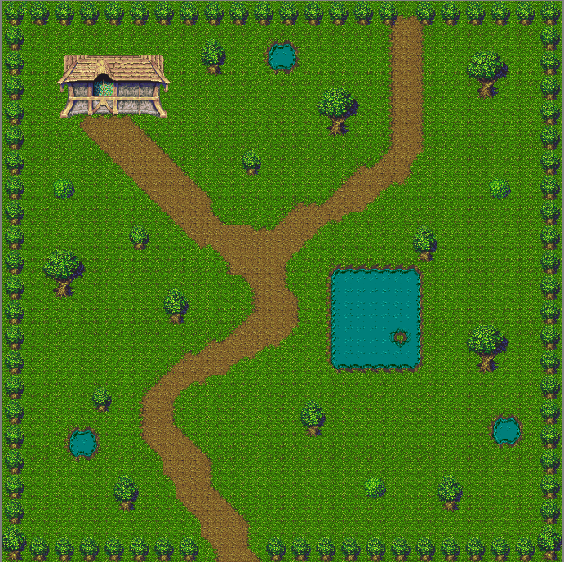
Starter Village

Slide 26
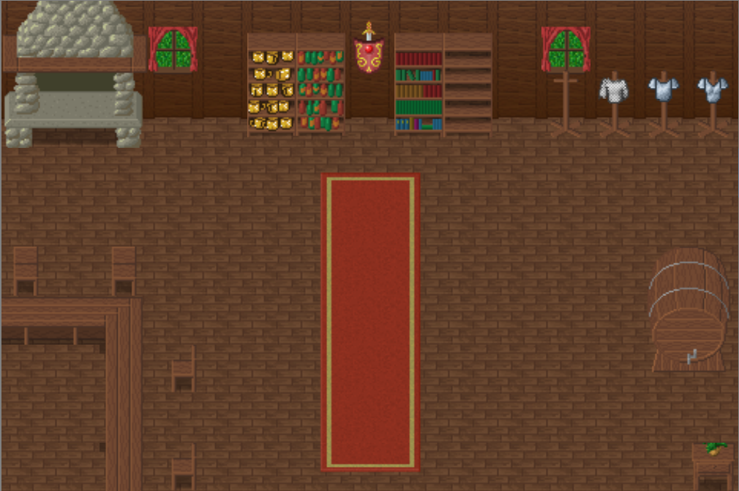
Inn

Slide 27
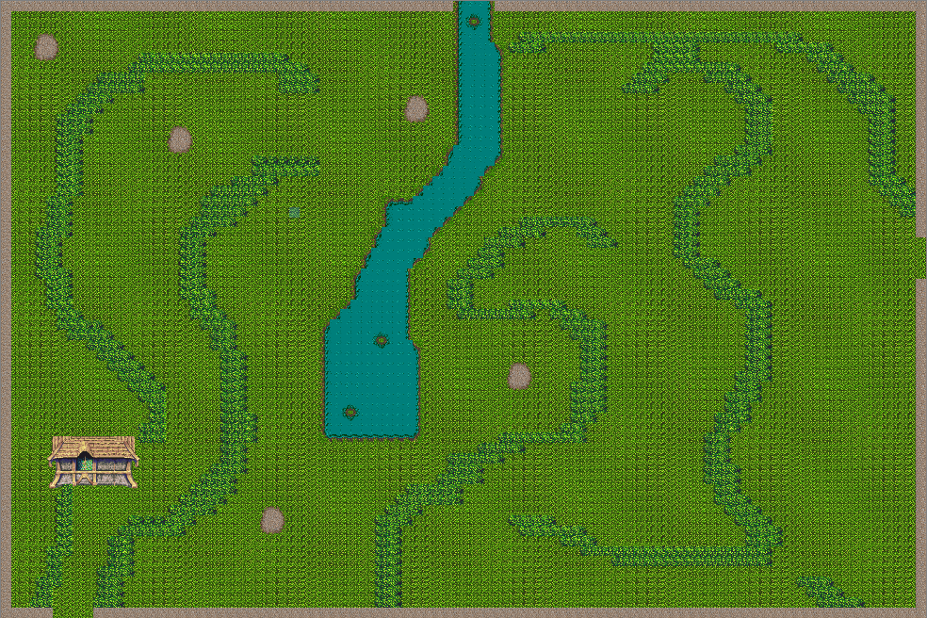
Plains

Slide 28
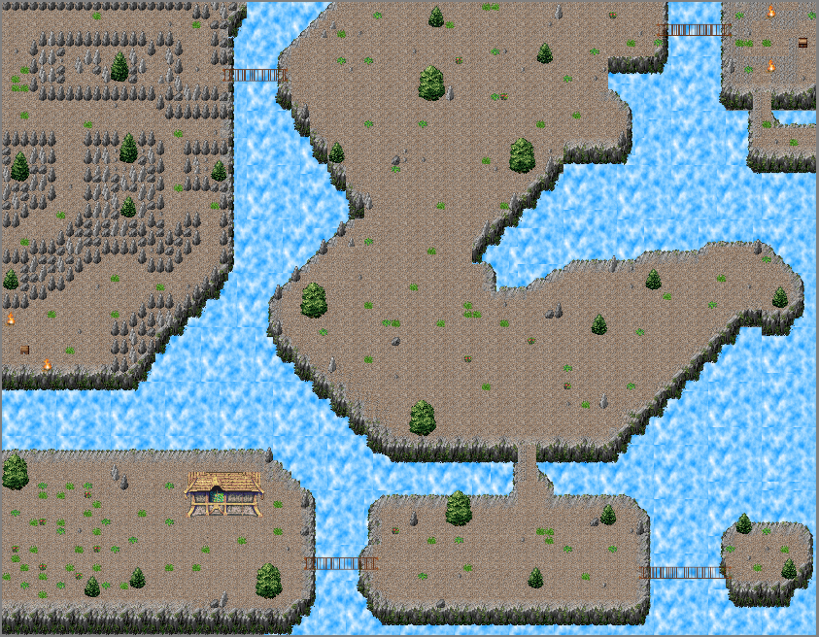
Mountains

Slide 29
Battle System

Slide 30
Battle System
Turn order based on internal haste value of the enemy
Each side takes turns
Continues until combat ends
Pop-up occurs at end of combat
Experience
Battle rations
Consumed on pickup
Health/resource gain
Does nothing if player has full health and full resource
Loot and inventory
Drag the desired items from loot box to inventory

Slide 31
Battle System
Battle effects
Blind – chance to miss – 2 turns
Daze – reduced damage – 2 turns
Poison – damage per turn – 2 turns
Burn – damage per turn – 2 turns
Chill – reduces defenses – 2 turns
Stun – blocks all attacks – 1 turn
Bleed – damage per turn – 2 turns

Slide 32
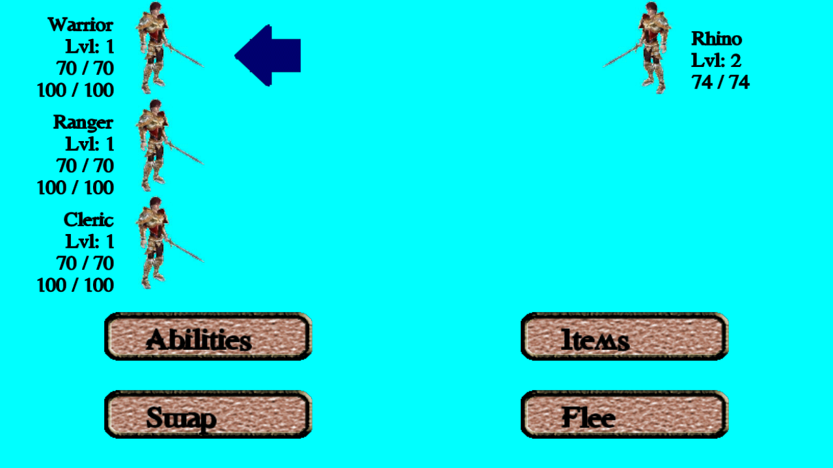
Battle System

Slide 33
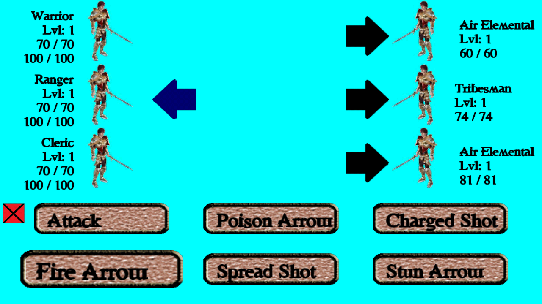
Battle System

Slide 34
Scope Cutbacks
Shop
Non-Playable Characters (NPCs) that generate a battle
Bosses
Treasure Chests
Quests
Challenges
Puzzles
Locked Doors
Cutscenes

Slide 35
Future
Classes
Assassin
Engineer
Mage
Knight
Zones
Caves
Desert
Tropics
Forest

Slide 36
Future
Fast Travel
Professions/crafting
Ally inventory
Persistent poison damage after battles
Micro-transactions
Currency
Diamonds
Allows instant access to content
Bundles
Remove ads

